Slide 1

Pneumonia Prediction in Chest X-Rays
Ali Malenchik

Slide 2

Background
Pneumonia is a respiratory infection that causes ~700K child deaths annually
Early diagnosis can prevent a patient’s condition from becoming more severe
Radiologists typically use chest X-rays to diagnose

Slide 3

Problem Statement
Can a machine learning algorithm accurately predict Pneumonia diagnosis using chest X-rays?

Slide 4
Scope & Assumptions
This project utilizes pediatric X-rays and may not be applicable to adults.
The X-ray diagnosis labeled in the dataset was reviewed for accuracy by multiple experts and is considered reliable.

Slide 5
Methods

Slide 6





Data Source
Sourced from Kaggle
JPEG format
Two labels: PNEUMONIA or NORMAL
Patients aged 1 – 5
Pre-split into test, train, and validation data
Pediatric patient X-rays were gathered from Guangzhou Women and Children’s Medical Center.
Low quality or unreadable images were excluded from the dataset.

Slide 7
Data Import & Cleansing
5216 X-rays in the training dataset
Imbalanced target class (1341 NORMAL, 3875 PNEUMONIA)

Slide 8
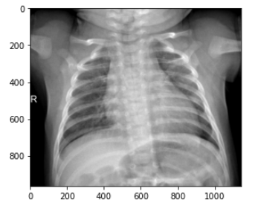
Exploratory Analysis Normal X-ray Sample 1

Slide 9
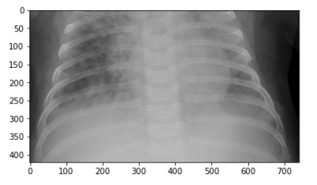
Exploratory Analysis Pneumonia X-ray Sample 1

Slide 10
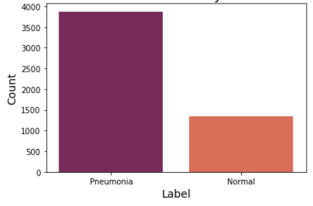
Exploratory Analysis Count Plot of Chest X-ray Label for Training Dataset

Slide 11
Feature Selection
Labels appended (PNEUMONIA, NORMAL) & separated into X_train, y_train
Features normalized using reshape()
Data augmented using ImageDataGenerator()

Slide 12
Model Deployment
Keras Sequential() model:
Four Conv2D Layers
Flatten Layer
Two Dense Layers
Compiled using RMSprop for optimization and Binary Cross-Entropy for loss

Slide 13
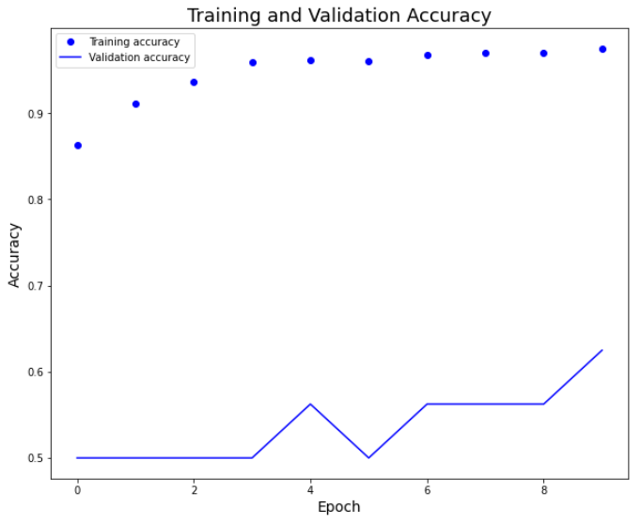
Results Plot of Training and Validation Accuracy

Slide 14
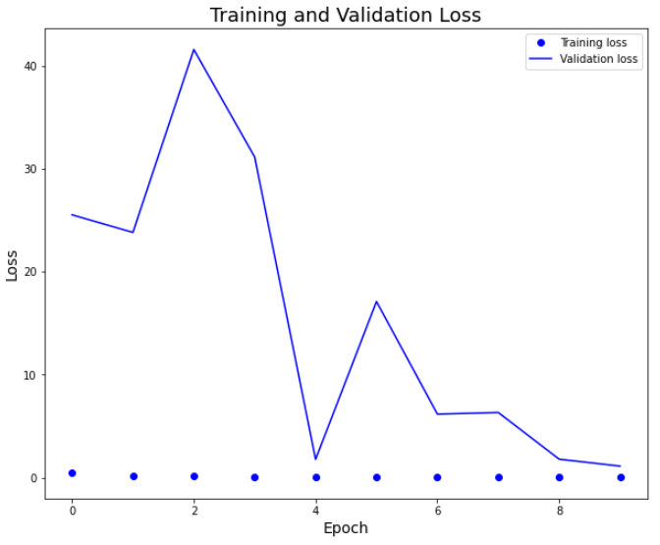
Results Plot of Training and Validation Loss

Slide 15
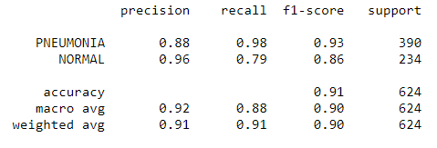
Results Classification Report

Slide 16
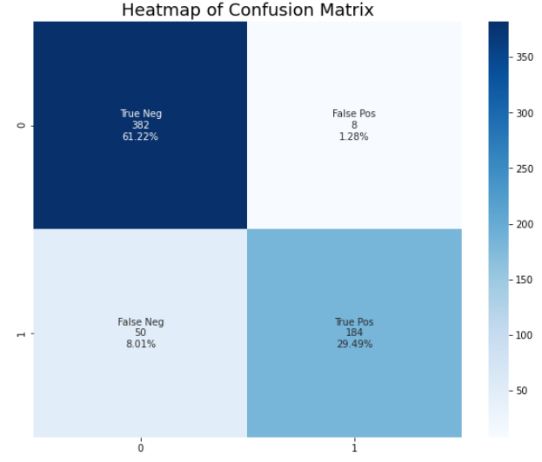
Results Heatmap of Confusion Matrix

Slide 17
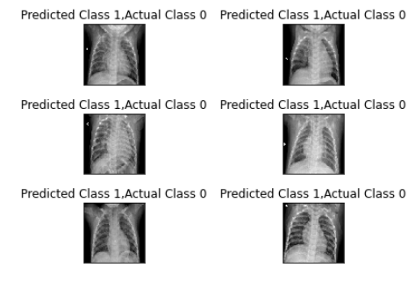
Results Sample Incorrect Predictions

Slide 18

Conclusion
The CNN model performed well at 91% accuracy.

Slide 19
Opportunities for Improvement & Next Steps
Tune parameters (activation function, loss function, optimization function)
Try model ensembles
More healthy X-ray image samples
Similar project for adult X-rays

